Slide 1
CSL-515 Data Mining
Project Presentation
Using Data Mining to make Recommendation for Movies to watch to any viewer
Sanskriti Chandra (24911021)
Tarushi Jain (25915024)
Atul Sharma (25911019)
Sumit Sharma (25911020)
Sara Mann (22114085)
Divij Rawal (22114031)
Guided By:
Dr. Durga Toshniwal
Professor, CSE IIT Roorkee

Slide 2
Introduction
The Problem
Over 500,000 titles on IMDb : viewers spend more time searching than watching
No built-in personalisation for new or anonymous users
Existing systems like Netflix require years of watch history to work well
IMDb's public data has no per-user ratings : standard Colllaborative Filtering is impossible
Our Solution
6 specialised mining modules, each working on different IMDb attributes
Modules predict independently, then votes are counted at integration
A movie recommended by 5 out of 6 modules is far stronger than one score
Works for any viewer : even with zero watch history (persona cold-start)

Slide 3

Team Members & Contributions
Key Contributions
# | Member | Key Contribution
1 | Tarushi Jain | Engineered regional diversity signal from alternate titles across countries and languages
2 | Sanskriti Chandra | Built content-based + implicit CF recommender using genres, cast, and decade features
3 | Atul Sharma | Mined actor co-occurrence graph with Louvain community detection for cast-similarity recommendations
4 | Sumit Sharma | Analysed ratings data : Bayesian quality ranking, classification, and outlier detection
5 | Sara Maan | Fingerprinted director styles using genre profiles and recommended movies by similar directors
6 | Divij Rawal | Built KNN, SVD matrix factorisation, and NLP title similarity ensemble for multi-model recommendations

Slide 4
Motivation & Problem Statement
1. Existing systems rely on user history : new or anonymous viewers get no personalisation.
2. IMDb's public dataset has no per-user ratings, making standard collaborative filtering impossible.
3. A robust system must work from movie metadata alone and still surface relevant, diverse recommendations.
500,000+
Titles in IMDb
89 %
Viewers struggle to choose

Slide 5
Dataset Overview
Dataset Source: IMDb Open Dataset
https://developer.imdb.com/non-commercial-datasets/
title.basics.tsv: Contains basic movie information.
Attributes: tconst, titleType, primaryTitle, OriginalTitle, startYear, runtimeMinutes, genres.
title.rating.tsv: Contain rating information.
Attributes: tconst, averageRating, numVotes.
title.akas.tsv: Contain alternative titles.
Attributes: titled, title, region, language.
title.crew.tsv: Contains movie crew information.
Attributes: tconst, directions, writers.
title.principals.tsv: Contains cast and crew roles.
Attributes: tconst, nconst, category, characters.
name.basics.tsv: Contains person information.
Attributes: nconst, primaryName, BirthYear/DeathYear, primaryProfession, knownForTitles.
title.episodes.tsv : Contains episode information.
Attributes: tconst, parentTconst, seasonNumber, episodeNumber

Slide 6

Data Preprocessing & Feature Engineering
Handling Missing Values
▸ Required columns (genres, startYear, averageRating, numVotes) : rows with missing values dropped
▸ Numerical columns (startYear, runtimeMinutes) filled with column median
▸ Remaining NaN fields (cast_ids, suspicious flags) filled with 0 or empty string
Feature Engineering
▸ Genre binary vectors via MultiLabelBinarizer ▸ Decade labels from startYear | log(numVotes)
▸ Diversity signal from AKA region/language counts (title.akas)
Data Transformation
▸ MultiLabelBinarizer for genre multi-label encoding
▸ StandardScaler (Z-score) for clustering features (averageRating, log_votes)
▸ Min-Max normalization for popularity score (year, runtime, genre count)
Integration Key
▸ All 7 files joined on tconst (IMDb title ID)
▸ Single file load : all modules share one copy in memory
▸ Large intermediates deleted with gc.collect() after each module

Slide 7
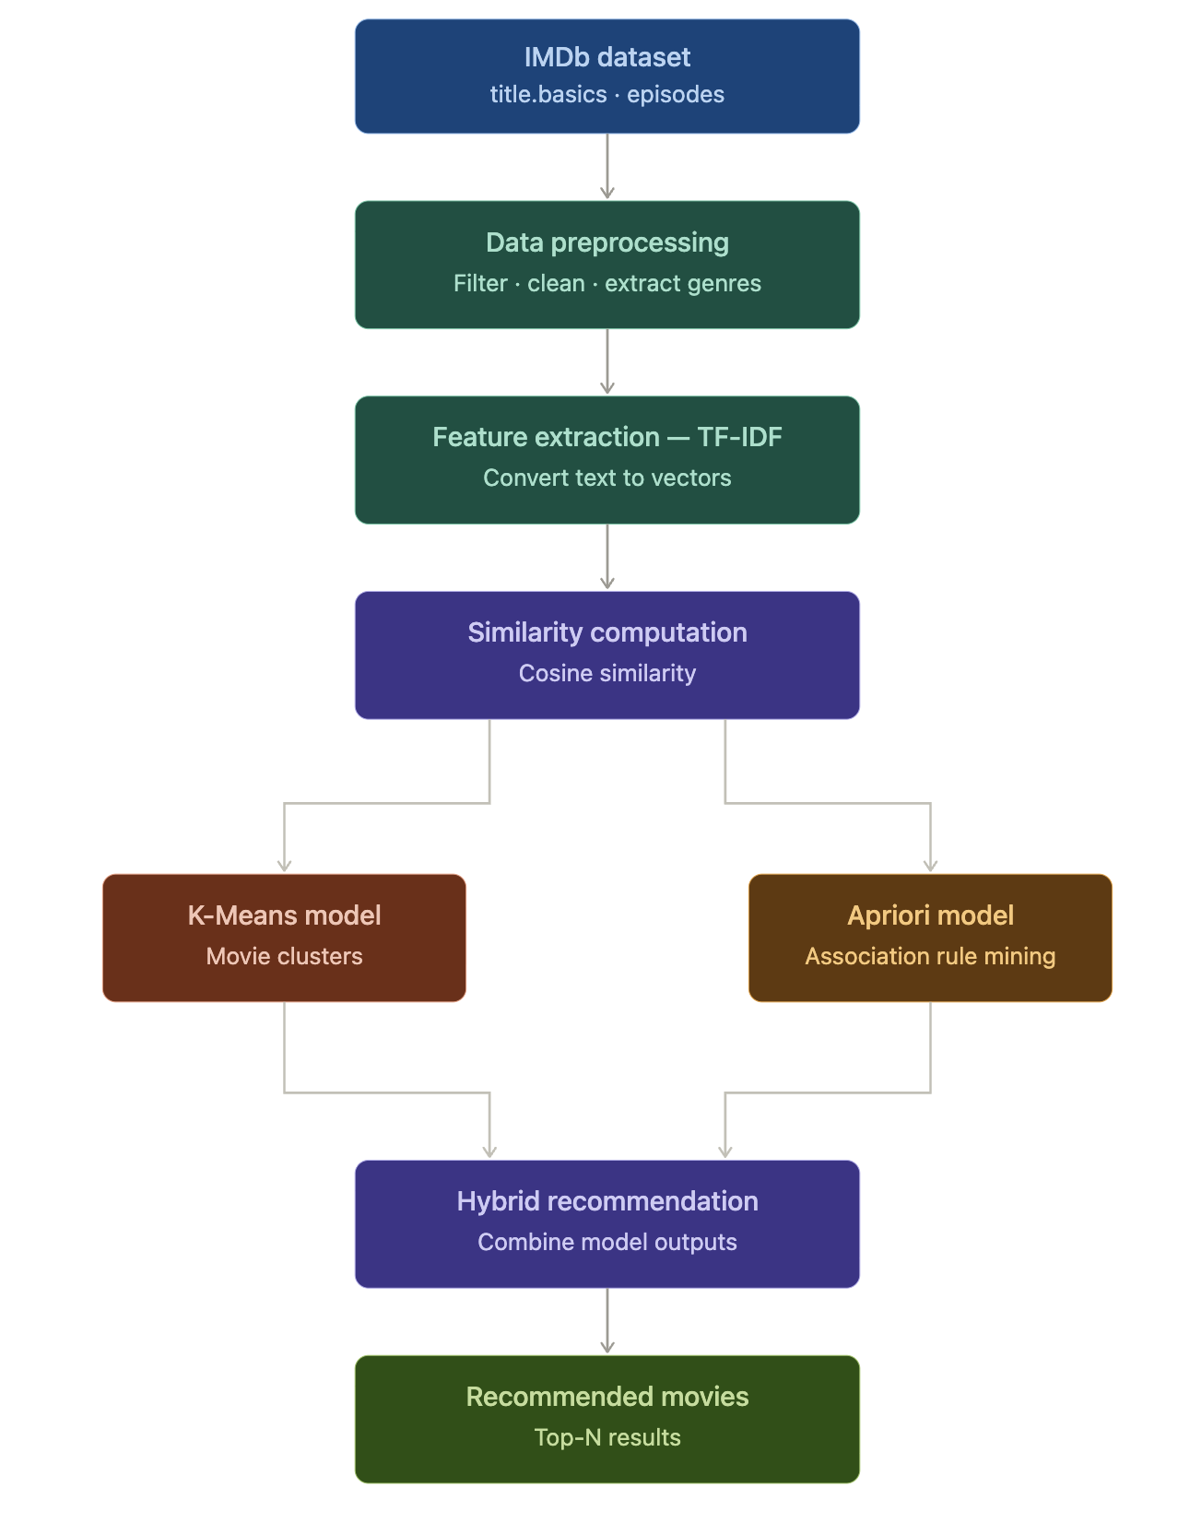
Task 1:
episode + basics files — handle TV series separately, recommend what to watch next after finishing a season or a show

Slide 8
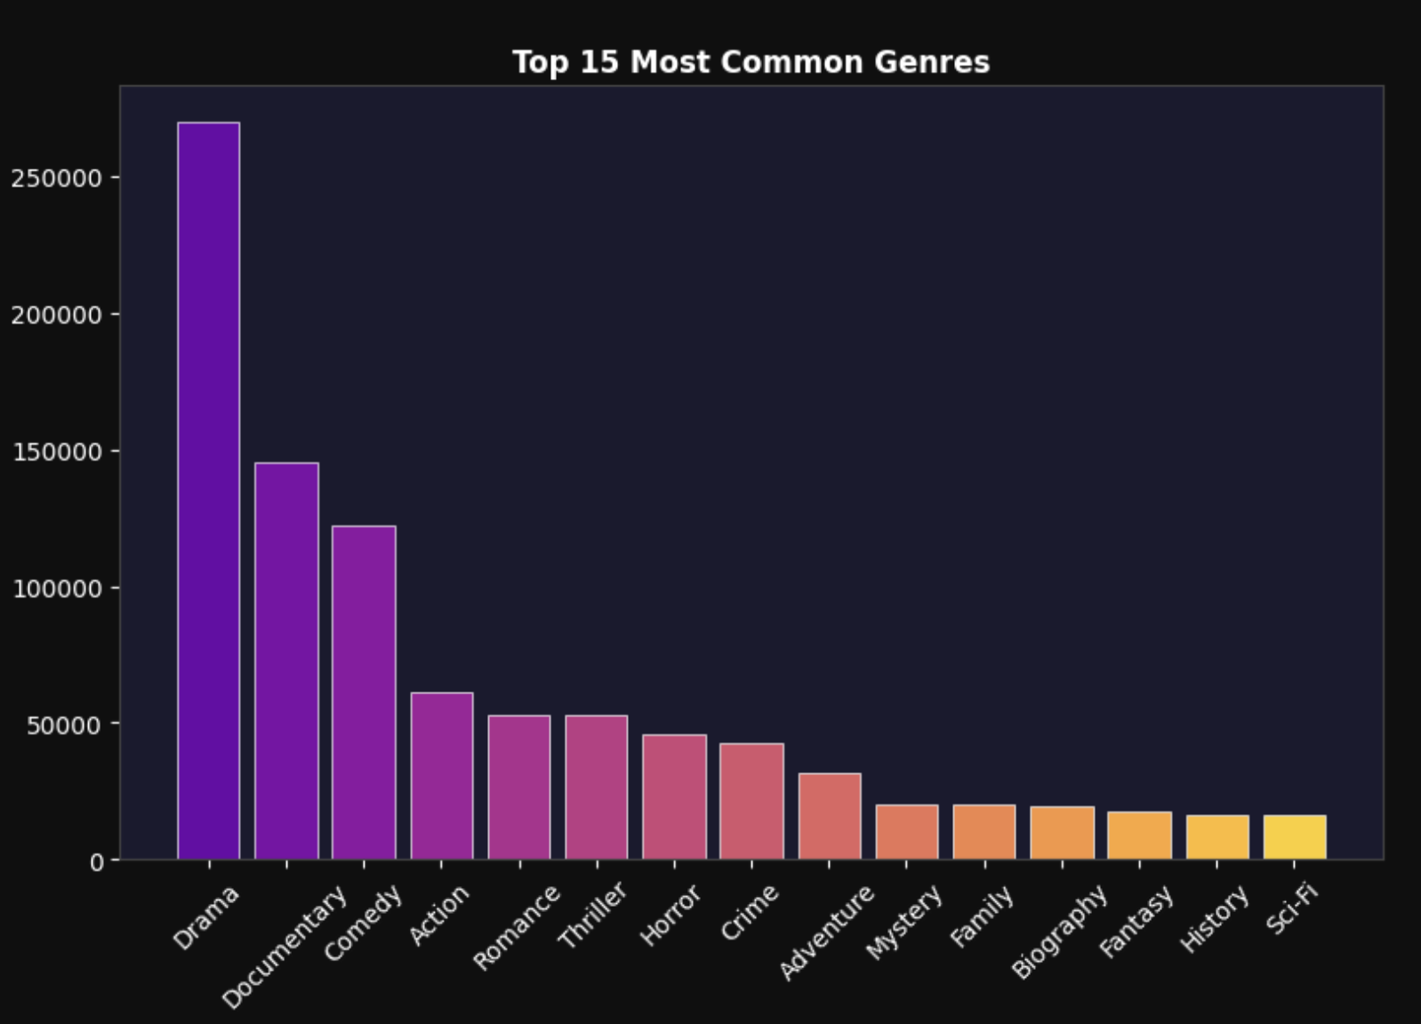
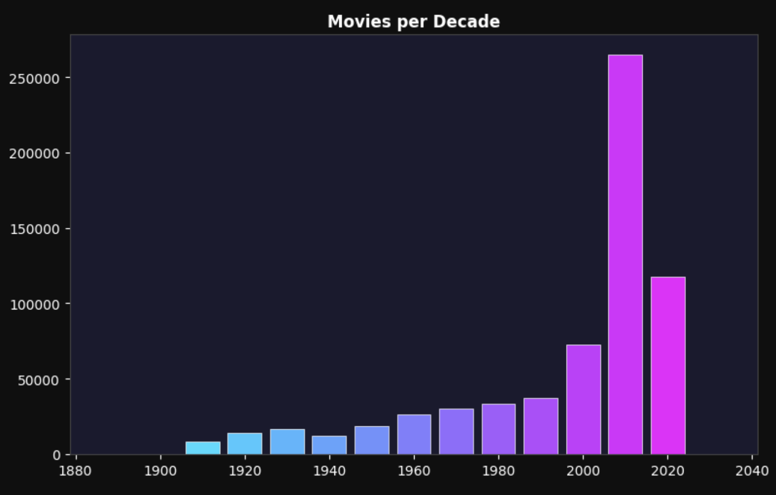
Exploratory Data Analysis(EDA)
EDA helps understand dataset patterns.
Key Observations:
Some genres appear more frequently.
Movie production increases in recent years.

Slide 9
Models Used
TF-IDF:
Converts movie descriptions into numerical vectors.
Highlights important words.
Cosine Similarity:
Measures similarity between movie vectors.
Used to find most similar movies.
K-Means Clustering (K=12):
Groups movies into clusters based on features.
Movies in the same cluster are recommended together.
Apriori Algorithm (min_support = 0.02, min_confidence = 0.3):
Finds frequent genre combinations.
Generates association rule like Action -> Adventure
Popularity-Based Filtering:
Acts as a cold-start solution when no user history is available.
Supports global and genre-scoped leaderboards.
Hybrid Model:
Combines similarity and clustering for better recommendations.

Slide 10
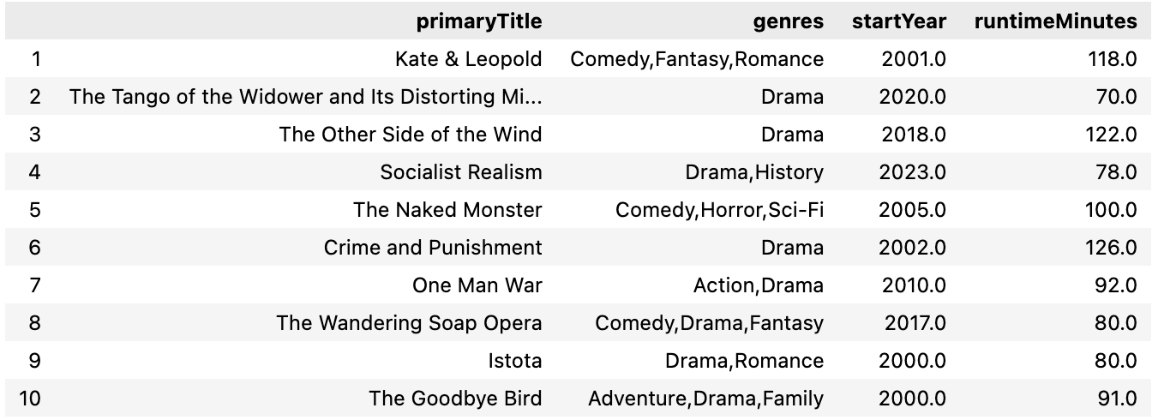
Recommendation system and Techniques used
Steps:
User enters movie title.
System processes movie features.
Similarity calculation performed.
Top recommended movies generated.
These techniques help group similar movies and generate recommendations.

Slide 11
Model Comparison
Performance | Model
Best Overall Model | Hybrid Recommender (8.5/10)
Best Personalisation | Content-Based Filtering (7.5/10)
Best Explainability | Association Rules (7.0/10)
Most Diverse Output | K-Means Clustering (6.5/10)
Fastest / Cold-Start | Popularity-Based (6.0/10)

Slide 12
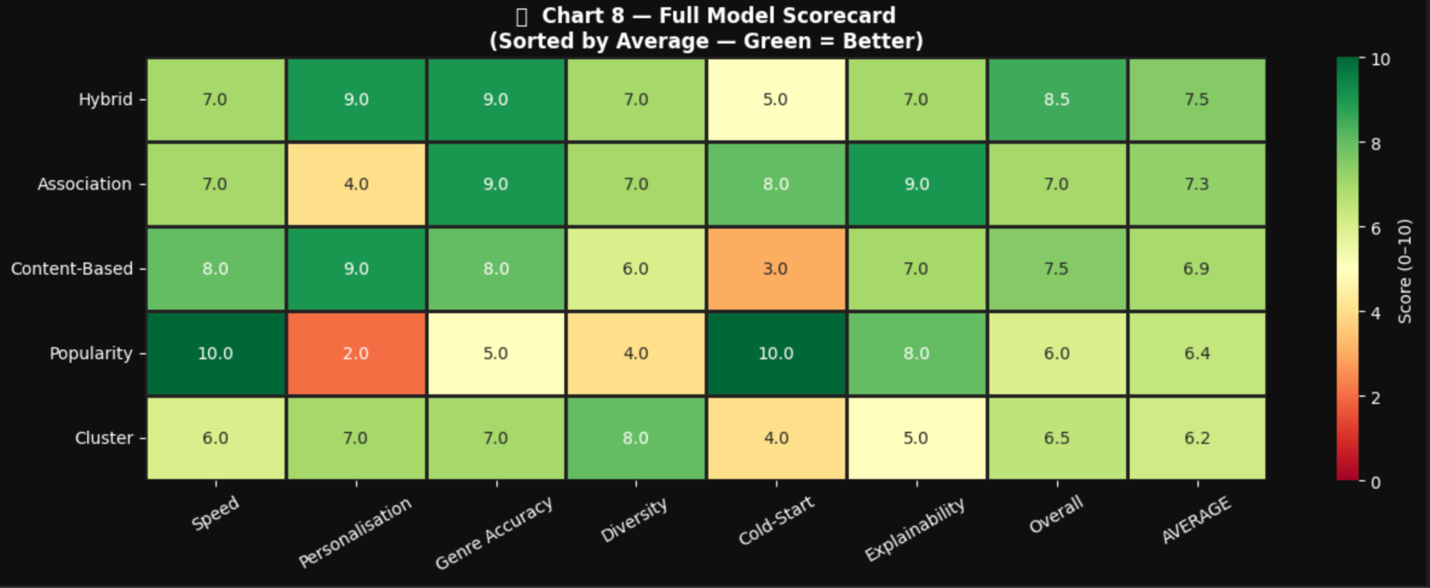
The Hybrid Recommender is the strongest model for real-world deployment because it combines the personalisation power of TF-IDF content based filtering with the reliability of popularity-based ranking.

Slide 13
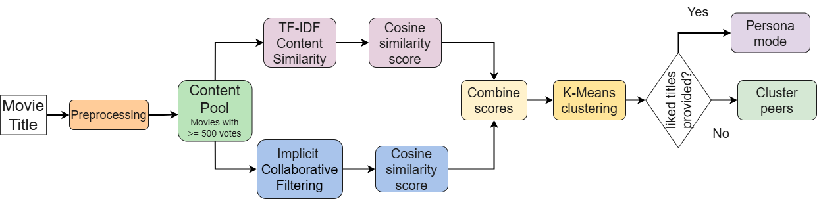
Task 2
Content-Based Filtering, Implicit Collaborative Filtering, & k-Means Clustering with Viewer Persona
Files Used: title.basics.tsv, title.ratings.tsv, title.principals.tsv
Attributes used :
basics : ['tconst', 'titleType', 'primaryTitle', 'originalTitle', 'isAdult', 'startYear', 'endYear', 'runtimeMinutes', 'genres']
principals : ['tconst', 'ordering', 'nconst', 'category', 'job', 'characters']
ratings : ['tconst', 'averageRating', 'numVotes']
Flowchart of the task:-

Slide 14
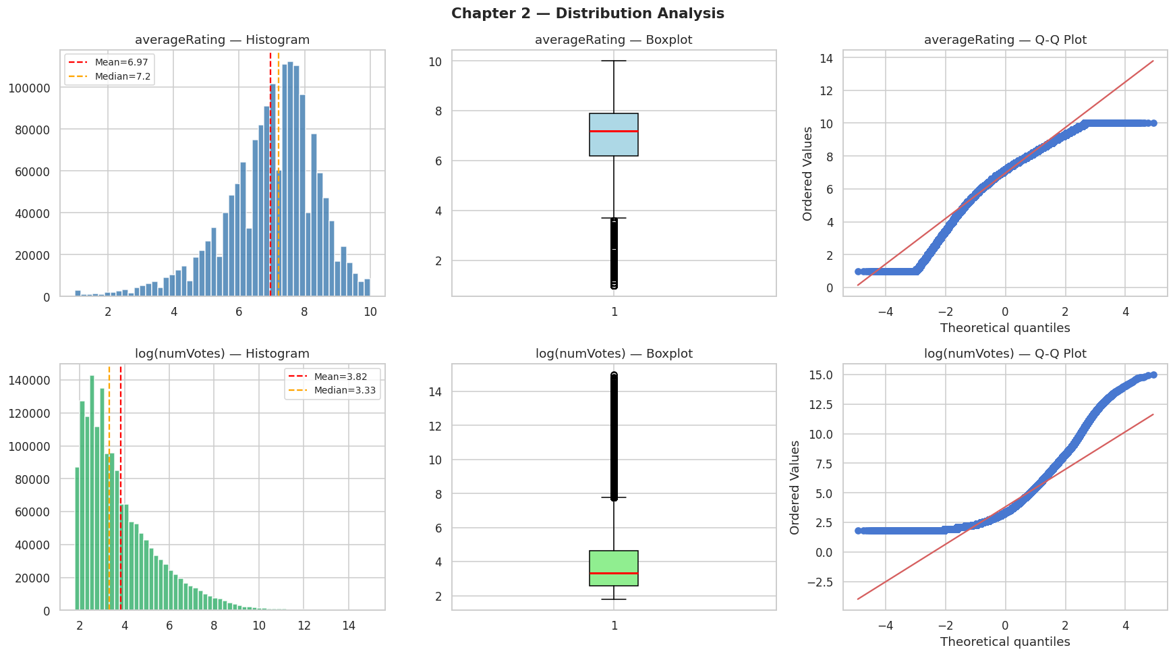
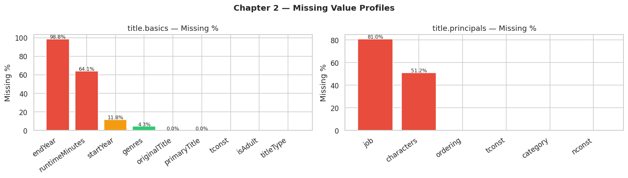
Task 2
Exploratory Data Analysis & Preprocessing :
1. averageRating is slightly left-skewed (most movies score 6-8). Mean vote = 1040
2.numVotes is extremely right-skewed : log-transform normalizes it well.
Fig. Missing attribute percentages from files title.basics and title.principals.

Slide 15
Task 2
2. Content-Based Filtering : Finds movies similar in genre, cast, and era to the query movie.
Total titles in basics(12,339,113); Movies only(739,633); Movies with ratings(340,178);
After dropping missing : 328,983 (removed 11,195), after thresholding 0f >= 500 votes,
Step | Detail
Input | genres (×3), cast IDs, decade token joined into one text string per movie
Model | TF-IDF Vectoriser max 5,000 features (68,862 unique movie titles.)
Similarity | Cosine similarity between query movie and all others
Output | Top-N most similar movies with a content score
3. Implicit Collaborative Filtering : Finds movies that appeal to the same type of viewer without any user data.
No user ratings → use implicit signals
Features:
Genre-wise rating deviation: Per Genre Average rating and, Each movie rating - Per Genre Avg. rating.
Popularity tiers (vote-based): num_votes (obscure,niche,known, popular, blockbuster)
Idea: Movies having similar deviations from similar genres attract same type of viewers.
Hybrid Model: Score=0.60×Content+0.40×CFScore

Slide 16
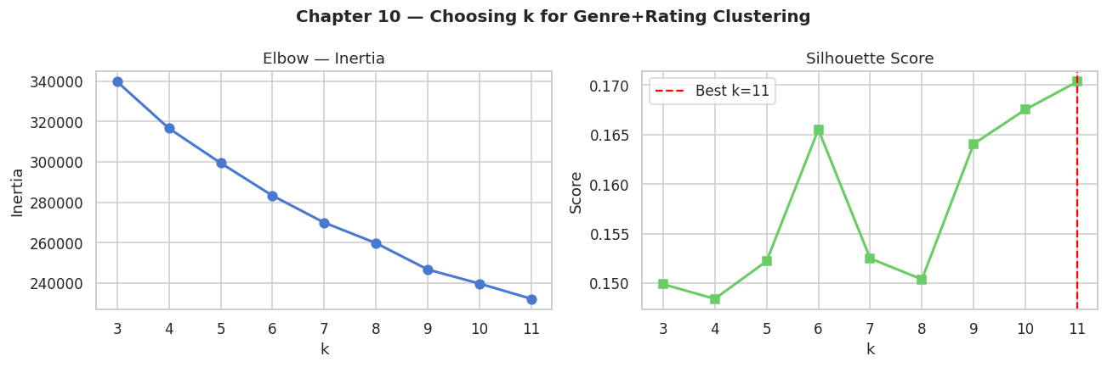
Task 2
4. k-Means Clustering + Viewer Persona: Groups movies into clusters, then uses those clusters to recommend to new viewers.
Step | Detail
Featuers | Genre binary columns + averageRating + votes
k selection | Silhouette score tested for k = 3 to 28, best k chosen automatically
Output | Each movie gets a cluster label
Viewer Persona:
Liked Movies
↓
Feature Representation
↓
Centroid Computation
↓
Nearest Cluster Detection
↓
Top Movies Recommendation

Slide 17
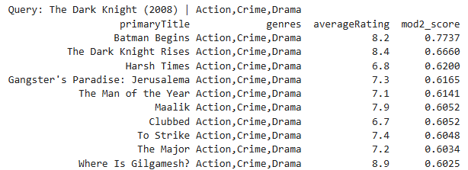
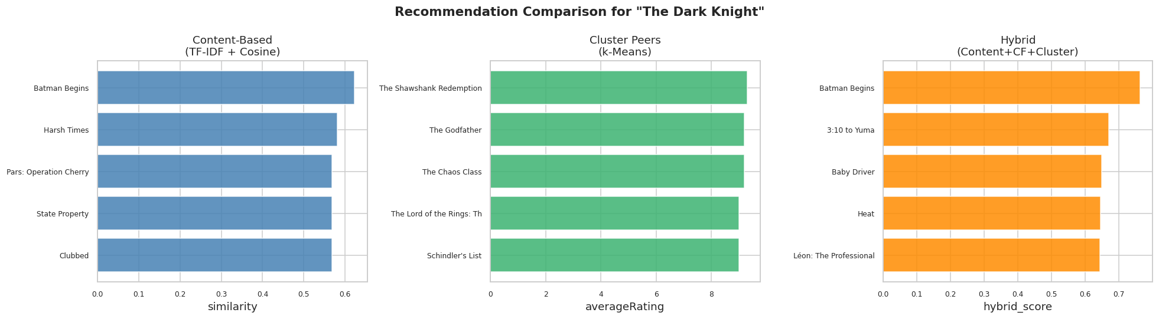
Task 2
Sample Output:

Slide 18
Task 4
IMDb Movie Rating Analysis and Evaluation
Files Used: ratings.tsv
Attributes used : 'tconst', 'averageRating', 'numVotes'
1. Exploratory Data Analysis
Techniques Used:
Mean → Average rating
Median → Handles skewed data
Mode → Most common rating
IQR -> Finds unusually high or low ratings
Skewness-> Measures data distribution shape
Histograms -> Shows how ratings and votes are spread
Scatter plots->Show how ratings and votes are spread
Correlation analysis->Measures relationship strength between variables

Slide 19
Task 4
Basic Statistics Table
Metric | Average Rating | NumVotes
Count | 1,644,346 | 1,644,346
Mean | 6.965 | 1,040.17
Std Dev | 1.414 | 18,181
Min | 1.0 | 5
25% | 6.2 | 12
50% | 7.2 | 27
75% | 7.9 | 103
Max | 10.0 | 3,164,347

Slide 20
Task 4
Central Tendency
Feature | Mean | Median | Mode
AverageRating | 6.965 | 7.2 | 7.2
NumVotes | 1040.17 | 27 | 8
Interquartile Range (IQR)
Skewness
Feature | IQR
Rating | 1.7
Votes | 91
Feature | Skewness
Rating | -0.857
Votes | 59.46
Relationship | Correlation
AverageRating vs numVotes | 0.0101

Slide 21
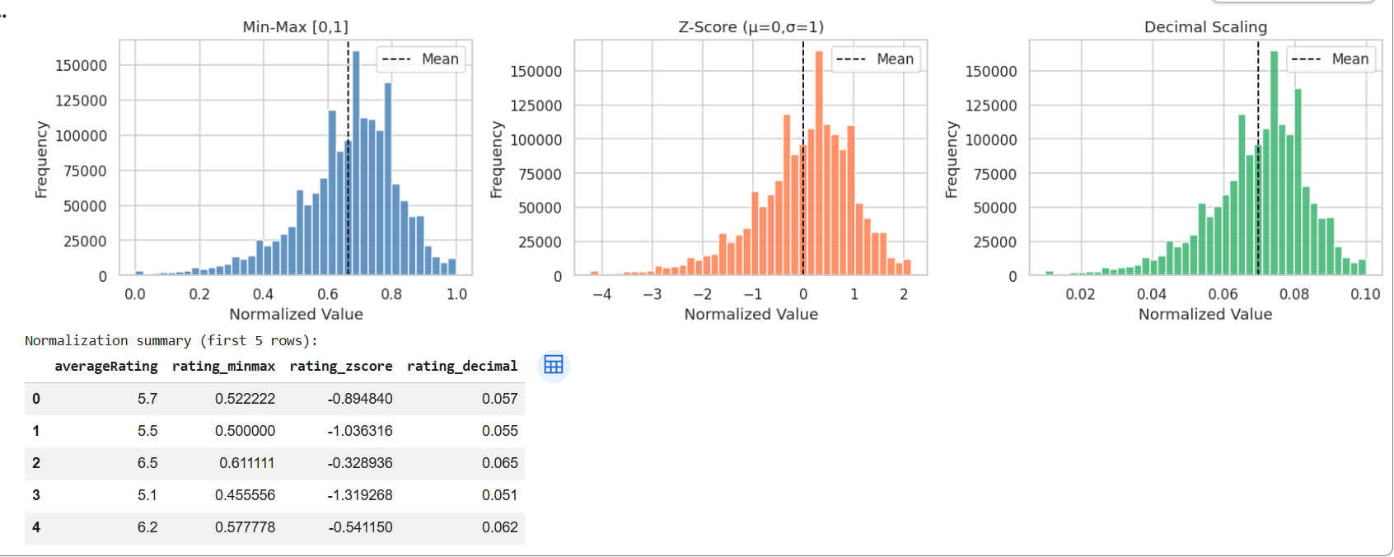
Task 4
Normalization Techniques
Normalisation is used to scale data into a common range to improve model performance and ensure fair contribution of all features.

Slide 22
Task 4
Rating Categorization using the binning technique
1. Equal-Width Binning (Left) 3. Custom Domain Binning (Right)
Divides data into equal ranges User-defined categories
Example: Example:
  1–3 → Very Low Poor (≤4)
  3–5 → Low Average (4–6)
  5–7 → Medium Good (6–7.5)
  7–9 → High Excellent (>7.5)
2. Equal-Frequency Binning (Middle)
Each bin has equal number of data points
Example:
  Bottom 20%, Next 20%, etc.

Slide 23
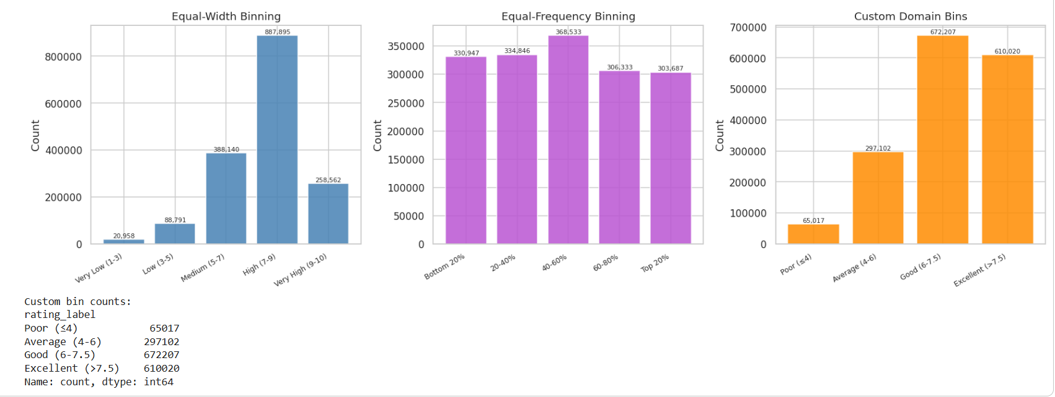
Task 4

Slide 24
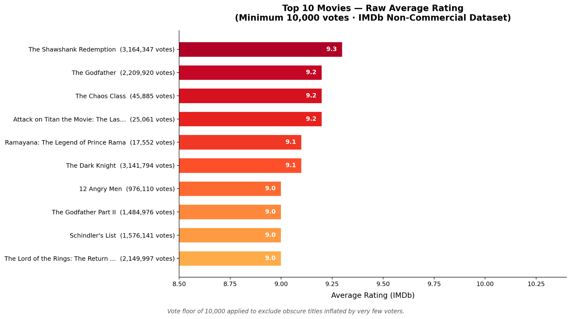
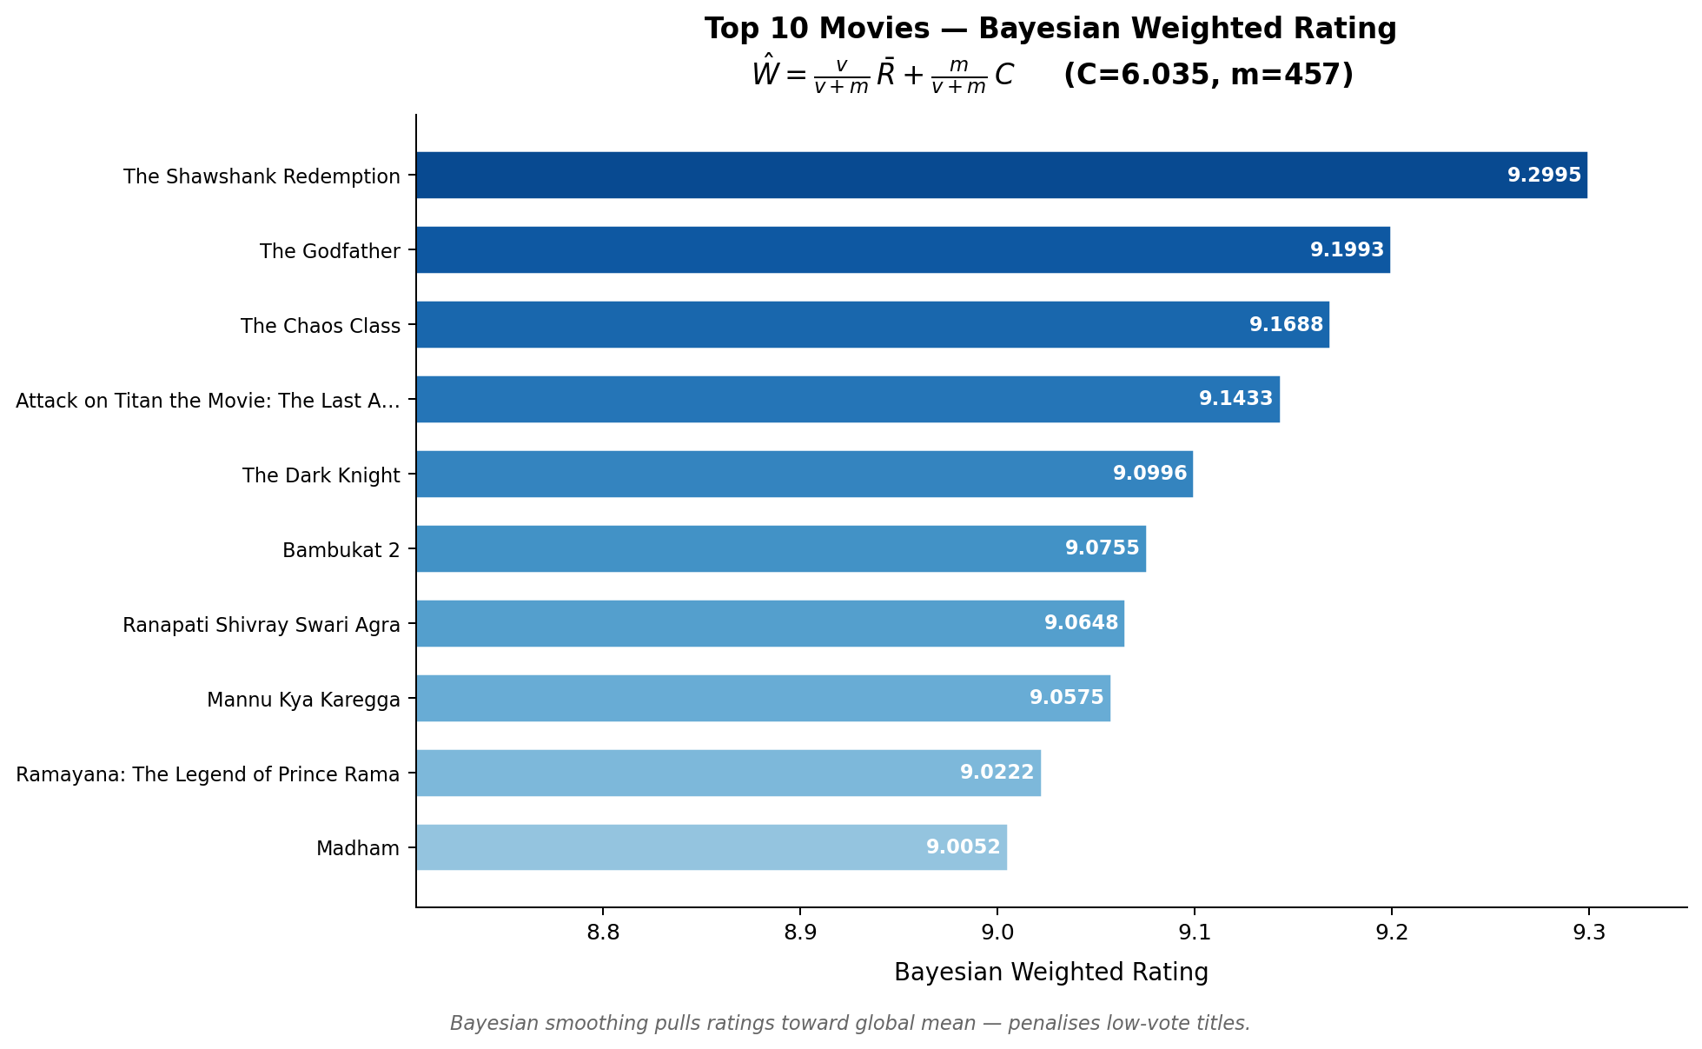
Task 4
Bayesian Weighted Rating Analysis
A movie with few votes (like 5 votes) can get 10/10 rating
That doesn’t mean it is truly the best movie

Slide 25
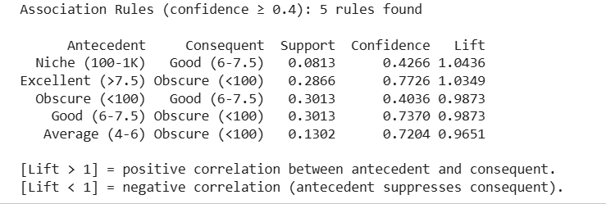
Task 4
Association Rule Mining (Apriori Algorithm Result)
It sho ws relationshipsbetween movie categories (like rating vs popularity).

Slide 26
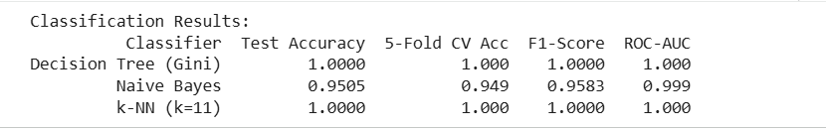
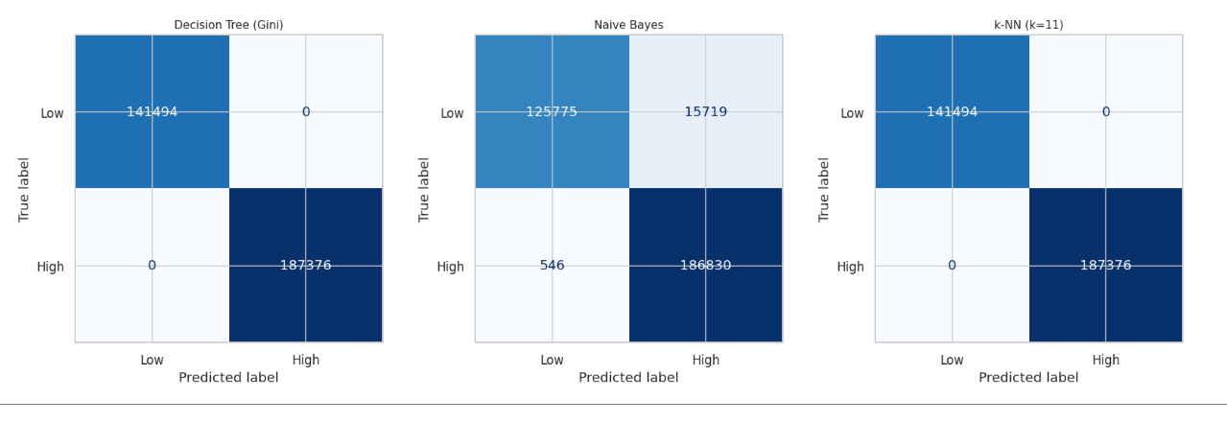
Task 4
Classification Model Performance Results
It shows how different models perform in predicting movie categories (e.g., High vs Low quality)

Slide 27
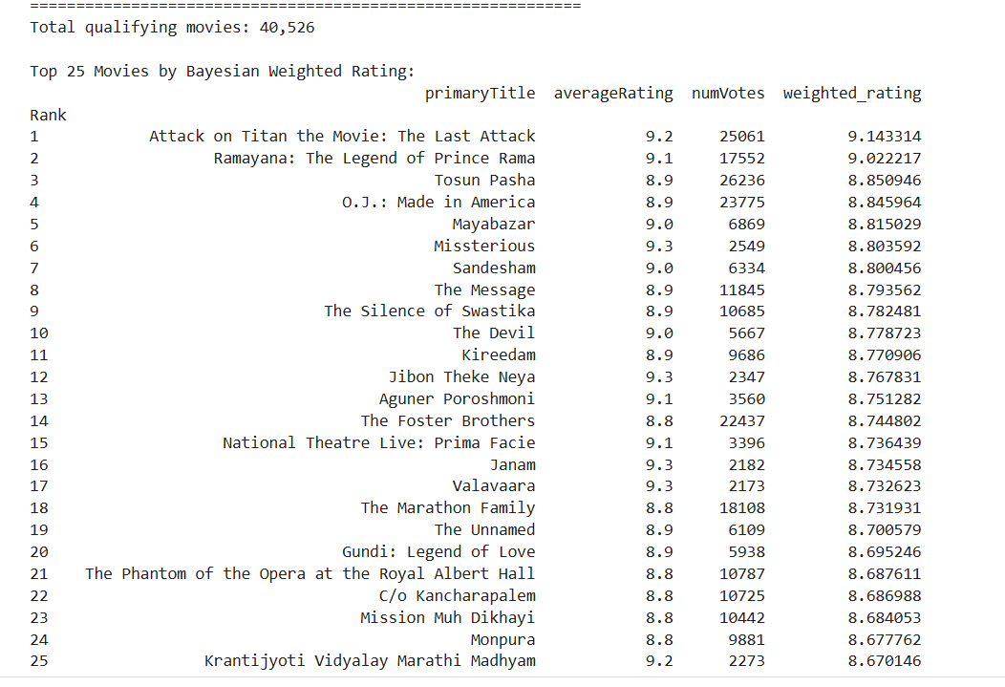
Task 4
Top 25 Movies Based on Bayesian Weighted Rating

Slide 28
Task 3 : Cast Graph & Community Detection
Counting shared actors is fast but treats every actor as equal. This module builds a global view of actor collaboration to detect creative circles.
Goal : Construct a graph where every node is an actor and every edge means they appeared in a film together.
Edge weight is the number of films they have shared. Frequent collaborators have thicker connections.
Ran Louvain community detection on this graph , this automatically groups actors into cinematic communities ( the Nolan circle, the Marvel ensemble, Bollywood clusters)
Built a scoring function with two parts :
- Part 1 - Direct overlap: how many actors appear in both films.
- Part 2 - Community bonus: how many actors in the candidate film belong to the same community as the query film's cast, even if they never directly co-starred
This score is passed into the team's hybrid recommender.

Slide 29
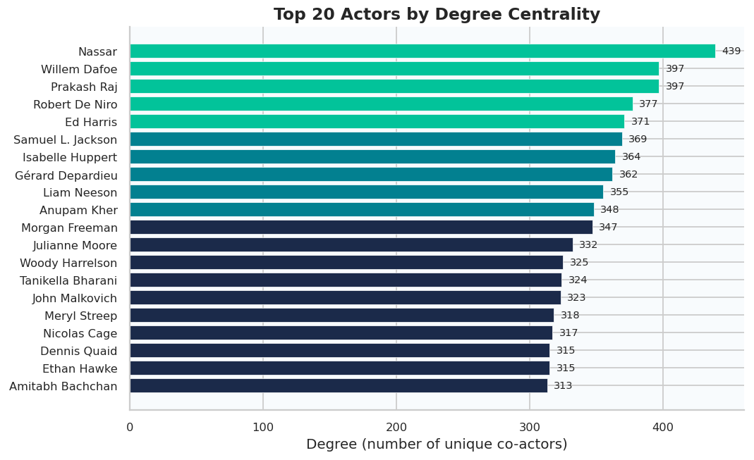
Degree Centrality & Community Detection
Degree Centrality :
In a graph, the degree of an actor node = number of unique co-actors they have worked with
An actor with degree 439 (e.g. Nassar) has appeared alongside 439 different actors across their career
High-degree actors are hubs , they bridge genre clusters and connect otherwise isolated parts of the network
Louvain Community Detection :
Louvain is an unsupervised graph partitioning algorithm that maximises modularity Q
Modularity Q measures how much more densely actors are connected within a community vs. across communities . Q = 0.67 here (strong partition, Q > 0.3 is considered good)

Slide 30
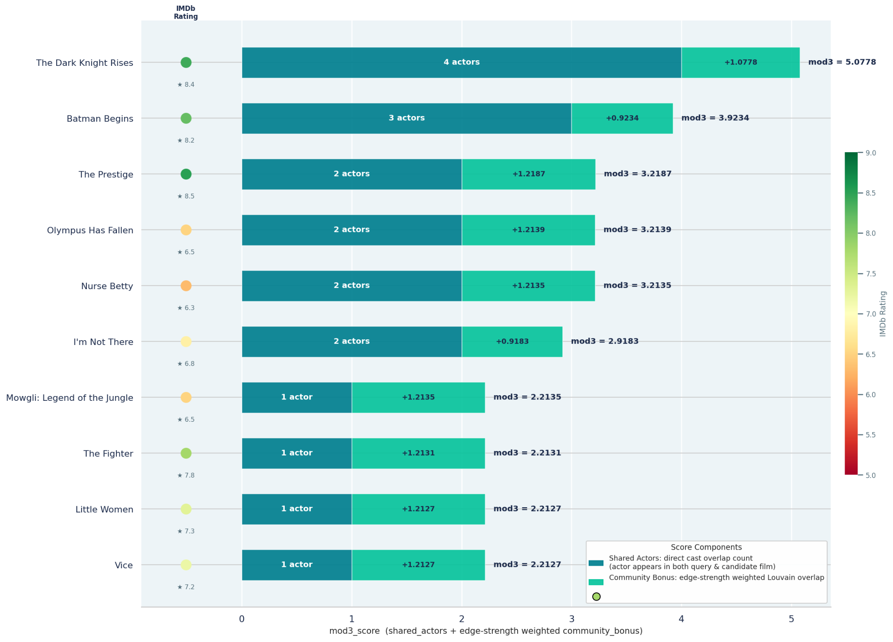
Scoring Function & Results
The direct overlap part rewards films that literally share cast members with the query film.
The community part rewards films whose actors work in the same creative circle as the query cast even if they never directly co-starred.
Both parts are added together, normalised, and passed into the team's hybrid integration layer.

Slide 31
Actor Collaboration Graph
How the graph is built:
Every node is an actor. Every edge means those two actors appeared in at least one film together.
Edge weight = number of films shared, the more films two actors have worked on together, the thicker the edge.
Node size is proportional to degree. actors with more co-stars appear as larger nodes.
Node colour identifies which film's cast the actor belongs to and each recommended film gets its own colour.
Layout algorithm used: Kamada-Kawai , here actors who collaborate more are pulled spatially closer together.
Hub actors sit at the centre Michael Caine and Christian Bale are the two largest teal nodes. They connect to almost every other cluster in the graph. Their high degree means any candidate film containing either of them scores highly on both direct overlap and community bonus.
Recommended films cluster by proximity Batman Begins and The Dark Knight Rises sit physically close to the teal query cluster dense connections, high scores. Olympus Has Fallen sits on the periphery it shares some actors but belongs to a different Louvain community, which is why its community bonus is lower despite having the same shared actor count as The Prestige.
Thick edges reveal the scoring backbone The thickest edge in the sub-graph connects Michael Caine and Christian Bale, labelled 5 they have shared 5 films together. This single connection is the structural reason The Dark Knight Rises and Batman Begins both rank at the top.

Slide 32
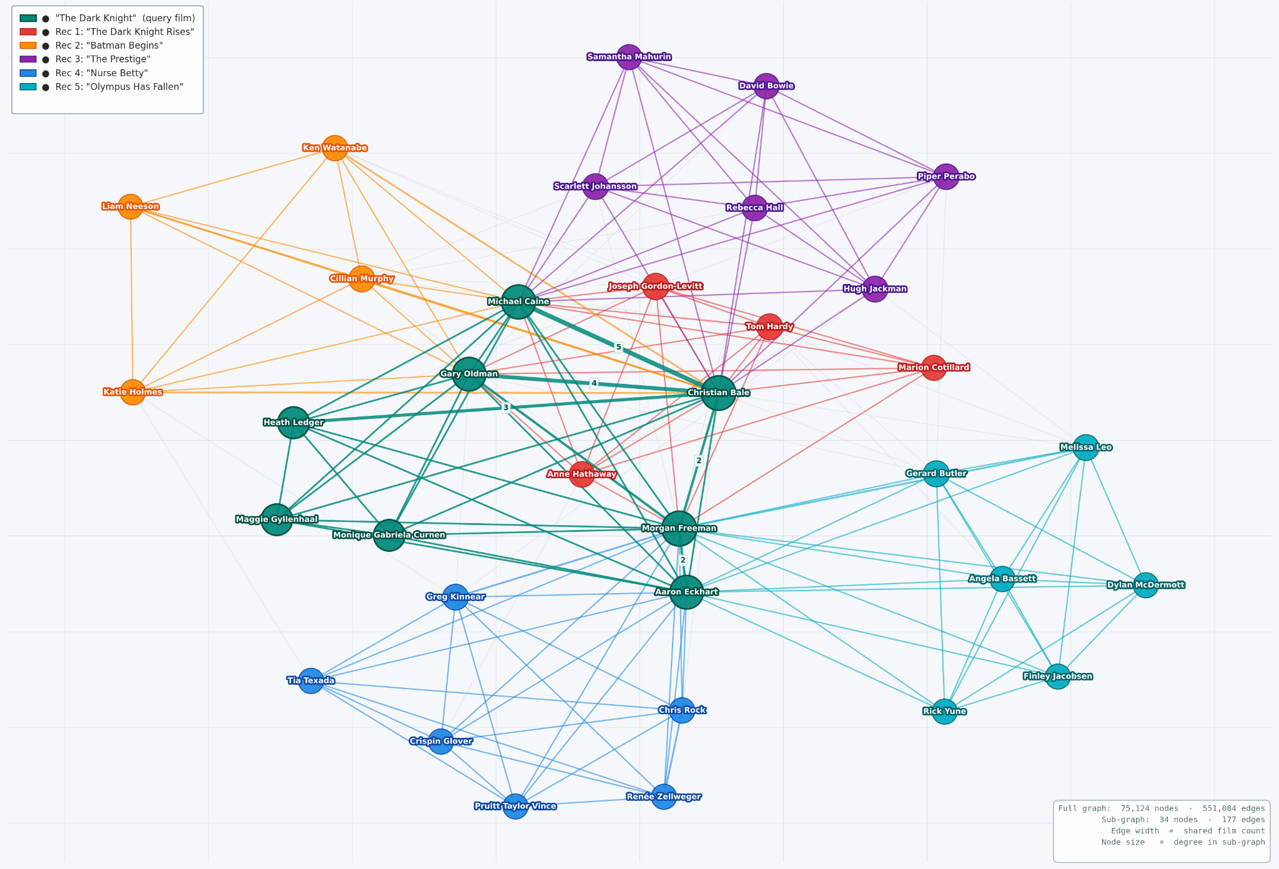
Actor Collaboration Graph

Slide 33
Output Recommendations
S.No | Primary Title | Genres | Avg Rating | Vote Count | Modules Used | Final Score
1 | Batman Begins | Action, Crime, Drama | 8.2 | 2 | mod2, mod3 | 0.7830
2 | Gangster's Paradise: Jerusalema | Action, Crime, Drama | 7.3 | 2 | mod2, mod6_knn | 0.7734
3 | Blood Work | Action, Crime, Drama | 6.4 | 1 | mod6_knn | 0.6998
4 | Blood and Bone | Action, Crime, Drama | 6.7 | 1 | mod6_knn | 0.6956
5 | 12th Fail | Biography, Drama | 8.7 | 1 | mod5 | 0.6951
6 | The Memory of a Killer | Action, Crime, Drama | 7.2 | 1 | mod6_knn | 0.6921
7 | Powder Blue | Action, Crime, Drama | 6.2 | 1 | mod6_knn | 0.6914
8 | Empire of the Wolves | Action, Crime, Drama | 5.8 | 1 | mod6_knn | 0.6897
9 | Rain Fall | Action, Crime, Drama | 4.6 | 1 | mod6_knn | 0.6848
10 | Face of Terror | Action, Crime, Drama | 4.3 | 1 | mod6_knn | 0.6838

Slide 34
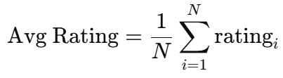

Evaluation Metrics
1. Combines Score : combined from all modules recommended it.
2. Diversity signal
Measures genre variation within recommendations
3. Average IMDb Rating
Ensures recommended movies are high-quality
4. Module Agreement (Vote Count)
Measures consensus across modules (confidence)
These metrics are only used after recommendations are already generated, purely to evaluate how good the system is.
Final Score=0.35×vote_count + 0.50×combined_score+ 0.15×diversity_signal

Slide 35
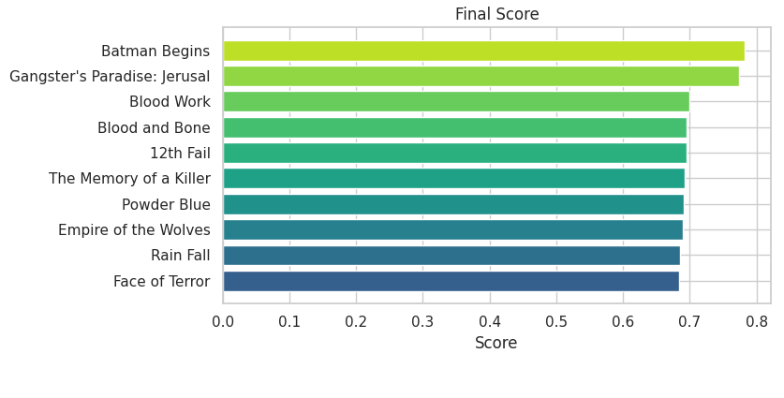
Result & key insights
The results show that hybrid fusion of modules improves both relevance and diversity compared to using a single method.
Hybrid model works effectively
Content similarity dominates
Collaborative signals refine ranking
High rating ≠ highest recommendation
System handles diversity

Slide 36
Challenges & Business Impact
No per-user ratings in IMDb : standard CF impossible; required implicit signal engineering.
Memory limits on Kaggle (~13GB free) : loading 7 large TSV files simultaneously caused OOM crashes.
title.principals.tsv has 50M+ rows : required column filtering at load time.
Actor graph grows exponentially : capped at 8 actors/movie and post-1980 filter to stay within limits.
Merging across 7 files with different schemas required careful tconst alignment.
Streaming platforms can deploy without user history : works for new viewers from day one.
Diversity signal ensures cultural inclusivity : not just mainstream Hollywood content.
Vote-based integration is transparent and auditable : each recommendation cites which modules agreed.
Scalable design: any new module can plug into the integration layer via tconst key.
Open dataset only : fully reproducible, no proprietary data required.

Slide 37
Conclusion
Built a hybrid movie recommendation system using IMDb data
Combined content-based, implicit CF, and clustering techniques
Used vote-based integration for robust final recommendations
Handled cold-start using Viewer Persona (k-Means)
Achieved accurate, diverse, and scalable results

Slide 38
Future Directions
Real User Data Integration
Connect MovieLens or similar open user-rating dataset via IMDb ID bridge for true collaborative filtering.
TV Binge-Path Sequencing
Use title.episode.tsv to recommend what to watch next after finishing a season or series — sequential recommendations.

Slide 39
Thank you!

